Slide 1
Open Source Software Report
Team LER: APH O&M Alexa Skill
Eric Schulze, Ryan Gosling, Larome Dickerson

Slide 2
Overview
Alexa O&M Trivia Skill
Used by APH to teach orientation and mobility to the blind and visually impaired

Slide 3
NodeJS
1. Are the open source license terms compatible with my business requirements?
Yes, the license gives full permission to use the software with no limitations free of charge.
2. What is the strength of the community?
The community is large and inclusive, which lets as many users contribute in any way they can.
3. How well is the product adopted by users?
It is well adopted by users.
4. Can I get a warranty or commercial support if I need it?
There is no warranty or commercial support for NodeJS
5. What quality assurance processes exist?
Quality assurance is performed by the community, Bugs are reported by users and fixed by the technical steering committee.
6. How good is the documentation?
The documentation is extensive and thorough.
7. How easily can the system be customized to my exact requirements?
It can be easily customized to meet our requirements
8. How is this project governed and how easily can I influence the road map?
NodeJS is governed by the technical steering committee. Contribution is encouraged which would let us influence the road map.
9. Will the product scale to my enterprise's requirements?
NodeJS is used by many large enterprises, so it will scale to our needs.
10. Are there regular security patches?
Security patches are released when found by the community. Since the Nodejs community is active security patches are done frequently.

Slide 4
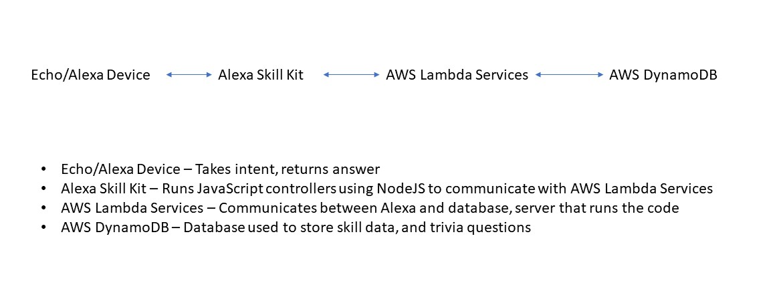
Amazon Proprietary Software

